Slide 1

MATH GAME PROJECT

Slide 2








CONTENTS
2.
1.
TEAM MEMBERS
TOPIC
2.
STAGES OF REALIZATION
4.
USED TECHNOLOGY
4.

Slide 3
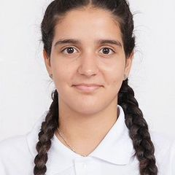
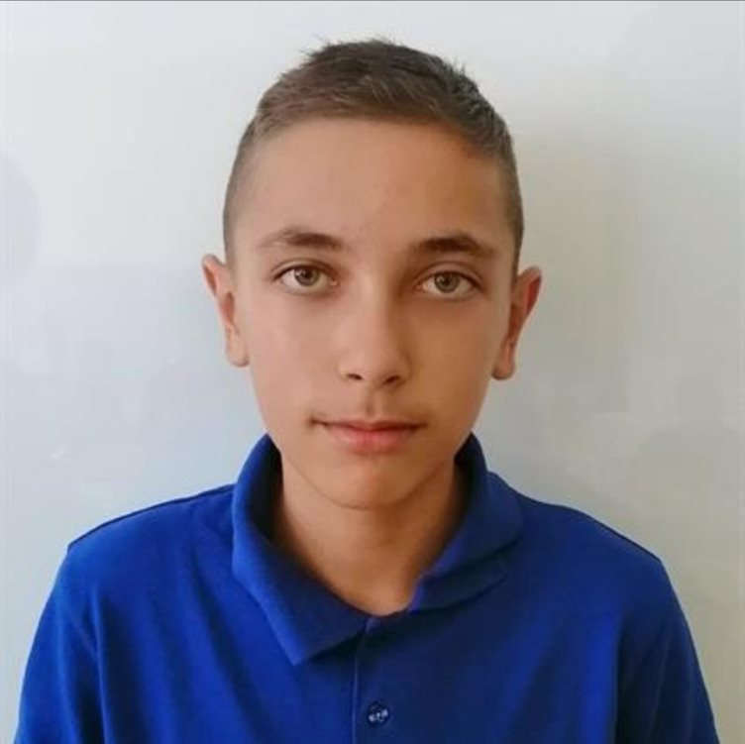
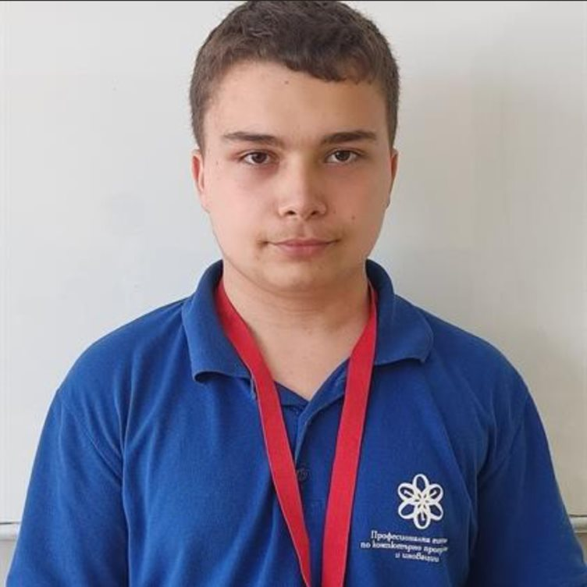
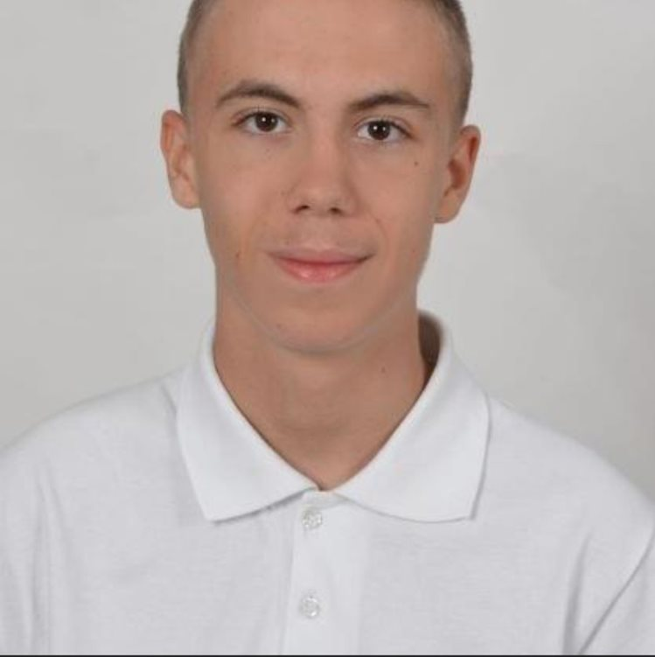
TEAM MEMBERS
Demetra Karagyozova
Miroslav Chobanov
Zafir Dinev
Miroslav Ivanov
Scrum Trainer
9g
Backend Developer
9v
QA engineer
9b
Frontend Developer
9a

Slide 4
TOPIC
The topic of this project is to make a C++ game with the theme "math game that uses bitwise operations". The main idea of ​​this project is to improve our programming skills and learn to work in a team.
Please keep this slide for attribution

Slide 5
STAGES OF REALIZATION
1
2
3
4
Organizing and giving everyone a role
Thinking of an idea
Realization
Presenting the final result

Slide 6












USED TECHNOLOGY

Slide 7
LET’S MOVE ON TO OUR PROJECT

